Slide 1
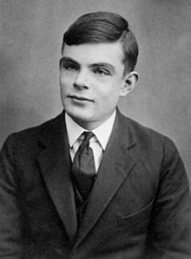
ALAN TURING : An Unsung Hero
Presented by : SNEHAL TAWAR

Slide 2

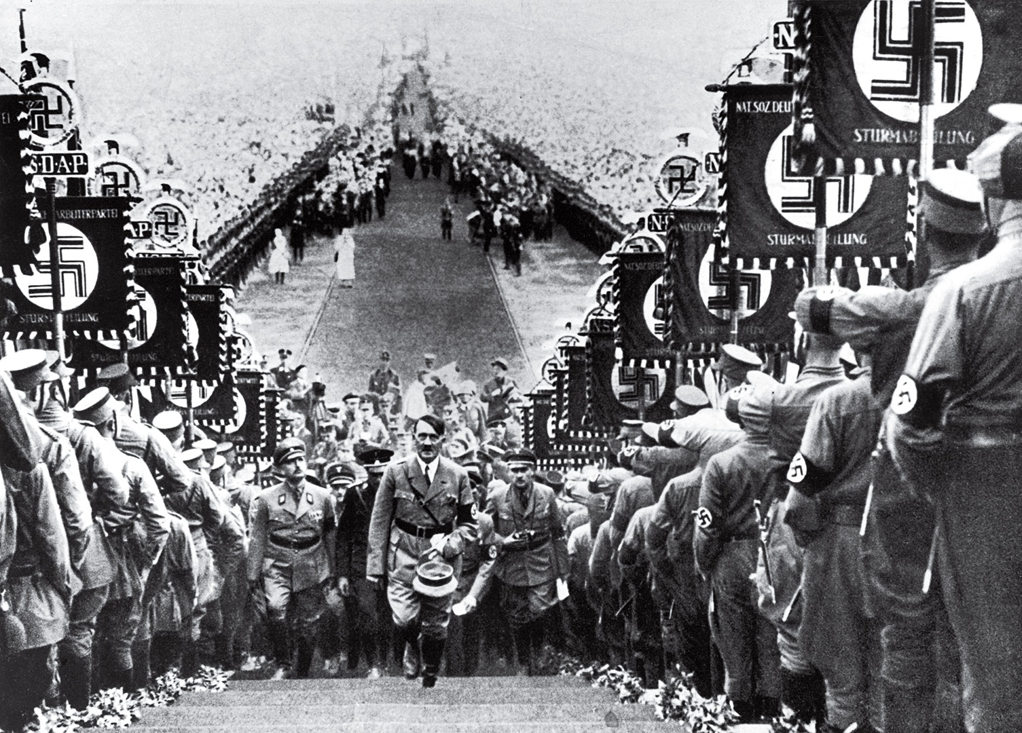


The First World War
Weimar Republic and The Treaty Of Versailles
3) Rise Of Hitler

Slide 3
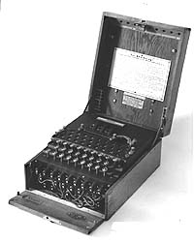
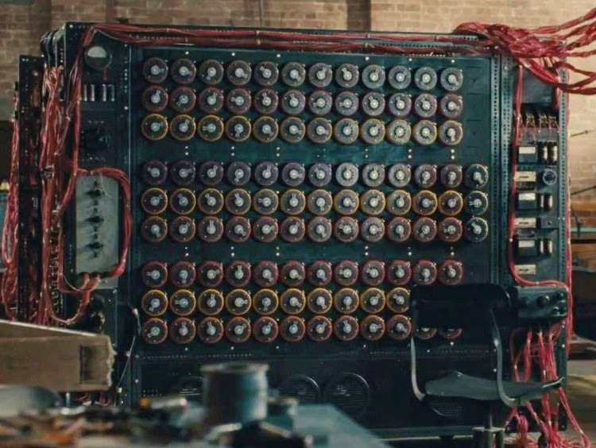
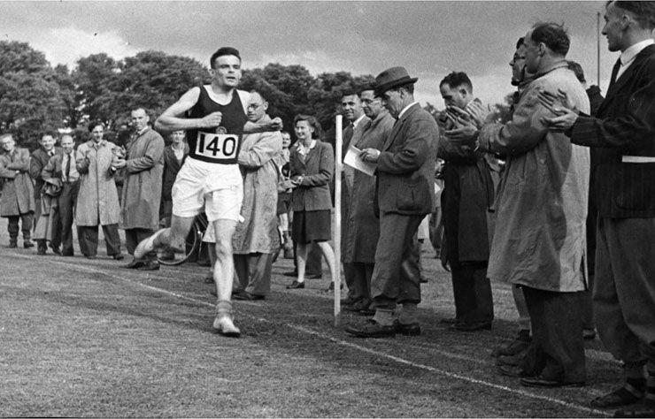
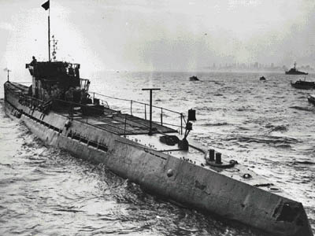
Allies and the Axis Power
The Enigma
Alan Turing and his work
ENIGMA
BOMBE
U-BOAT

Slide 4

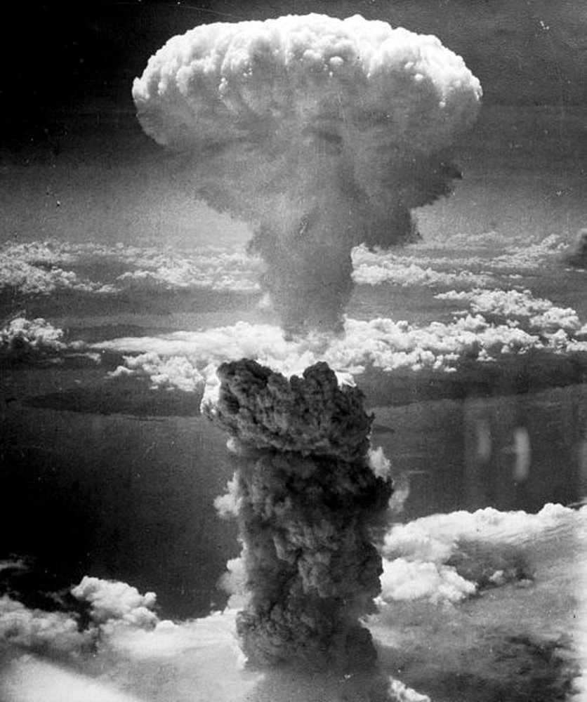
Contributions
The Present.

Slide 5
THANK YOU .

